Slide 1
Intermediate Coding Week 2
Review, continued

Slide 2

Conditionals Review

Slide 3
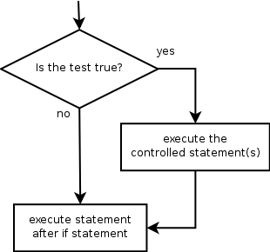
The if statement
Executes a block of statements only if a test is true
if (test) {
statement;
...
statement;
}
Example:
Scanner console = new Scanner(System.in);
int cents = console.nextInt();
if (cents == 25) {
System.out.println(“Quarter accepted. Here is your gumball.");
}
Notes:
Bring up logical operators

Slide 4
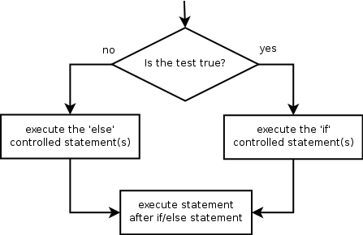
The if/else statement
Executes one block if a test is true, another if false
if (test) {
statement(s);
} else {
statement(s);
}
Example:
int password = console.nextInt();
if (password == 0) {
System.out.println("That’s not a very good password. Make a new one.");
} else {
System.out.println("You’re good to go!");
}

Slide 5
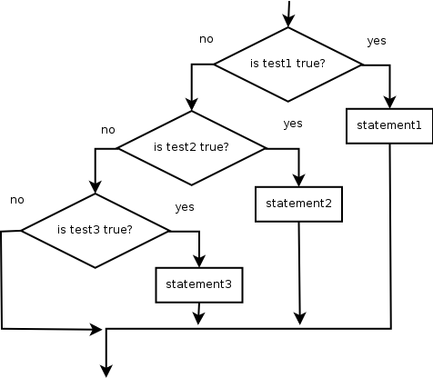
The if/else if statement
If it ends with else, exactly one path must be taken.
If it ends with if, the code might not execute any path.
if (test1) {
statement(s);
} else if (test2) {
statement(s);
} else if (test3) {
statement(s);
}
Example:
if (place == 1) {
System.out.println("Gold medal!");
} else if (place == 2) {
System.out.println("Silver medal!");
} else if (place == 3) {
System.out.println("Bronze medal.");
}
Notes:
Explain that it can end with else or nothing.

Slide 6

Examples We Talked About During Class

Slide 7
Question 2
Write a program to reverse the digits in an integer.
Sample run(s) of the code:
What is your number? 12345
54321
What is your number? 7352
2537
Can you do this only with loops and variables?

Slide 8
Question 6
Write a program to read in integers until a sentinel, and calculate the range and the mean of the integers.
Sample run(s) of the code:
Enter a number (999999 to quit): 14
Enter a number (999999 to quit): 10
Enter a number (999999 to quit): 3
Enter a number (999999 to quit): 11
Enter a number (999999 to quit): 19
Enter a number (999999 to quit): 999999
The range is 16. The mean is 11.4.

Slide 9
Problems

Slide 10
Question 1
Write a program to check if a number is prime.
Sample run(s) of the code:
What is your number? 91
91 is not prime.
What is your number? 97
97 is prime.
What is your number? 1
1 is not prime.
For an extra challenge, print out the factors of the number if the number isn’t prime.
What is your number? 91
91 is not prime. Its factors are: 7 13

Slide 11
Question 2
Using your code for Question 1, write a program that calculates all the prime numbers less than or equal to a certain number.
Hint: you might want to use a method!
Sample run of the code:
What is the upper bound? 30
2 3 5 7 11 13 17 19 23 29

Slide 12
Question 3
Using your code from Questions 1 and/or 2, write a program to find the last prime number before a given integer.
Sample run(s) of the code:
What is the upper bound? 100
The last prime before 100 is 97.
What is the upper bound? 150
The last prime before 150 is 149.

Slide 13
Question 4 (Challenge*)
Two people are painting a fence. If you imagine the fence as a one-dimensional number line, John paints one interval of the fence and Bessie paints another interval of the fence which may possibly overlap with part or all of John’s interval.
Please help John and Bessie determine how much of their fence is painted.
The ends of the intervals are guaranteed to be integers between 0 and 100.
Sample run(s) of the code:
What is John’s interval? 7 10
What is Bessie’s interval? 4 8
6 units of fence are painted.
*This question is adapted from a previous USACO Bronze problem.
Notes:
The original problem statement is here: http://www.usaco.org/index.php?page=viewproblem2&cpid=567
Problem Credits: Brian Dean

